Slide 1
The Missing Link in Prison-to-Community Transition

Slide 2
Our Mission
PHOENIX Rising Transitions is a grassroots community-based organization that provides transitional support including education, mentoring and community building with special concern for releasing convicts, ex-convicts and their families, crime victims and the community at large.

Slide 3
Our Method: Establishing the conditions wherein transformation may occur
Intentional Interaction:
Conversations Between
Convicts/Ex-Convicts
and Community Members
InReach Projects
Leadership Class
Life Skills Classes
In-the-Community Projects
Mentoring
Transition Housing
Community Organizing
Public Speaking

Slide 4
Some Alarming Statistics
Prisoner health is worse than the general population at an otherwise similar demographic threshold and can decline dramatically upon release.
Ex-convicts are 12.7 times more likely to die within two weeks of release from prison compared to the general population.
One in twelve ex-convicts are hospitalized within 90 days of their release.

Slide 5
Barriers to Access
Trust issues
Unfamiliarity with the process and culture
Transportation
Health care perceived as a luxury
Feeling overwhelmed at release
Delays in getting signed up for Oregon Health Plan

Slide 6
Health Challenges
Chronic Disease
Mental Illness
Accidents
Inadequate Information
Privacy and Health Education
Problems with Pain and Pain Medications

Slide 7
Contributing Problems
Have been told what to do for months or years
Sensory overload – overwhelmed by a multiplicity of choices in the world
Easily frustrated and “turned off”
Bring prison values from “the yard” into the streets
Fear of being stereotyped
Need for being treated with RESPECT (with a distinct cultural definition)

Slide 8
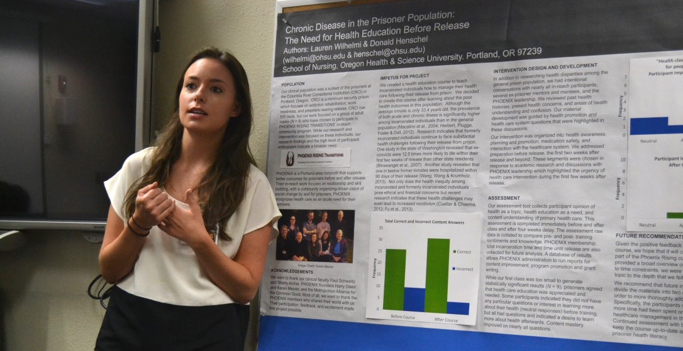
Relationship with OHSU School of Nursing
In 2013 PHOENIX began a partnership with OHSU School of Nursing, serving as a practicum site for students studying the needs of specific populations. Their research and interviews with PHOENIX members have uncovered specific needs, experiences and attitudes that impact ex-convict health. We wish to educate the medical community about this special subculture and educate prisoners and ex-convicts about taking responsibility for their own health.

Slide 9
Educational Intervention
Community Nursing student project through OHSU
Within PHOENIX leadership training
Questions-based education project
What most interested the participants?
Pragmatic approach to education and attitude
Measuring knowledge and attitude change
Plan to continue training in future leadership courses

Slide 10
Do you work with ex-cons? Probably!
1 in 100 Americans is in prison
14,706 people are locked up in 14 state prisons in Oregon (July 2015)
95% of all prisoners will eventually be released
1 in 33 Americans is on supervision
32,621 people in Oregon are on some form of community supervision (April 2015)

Slide 11
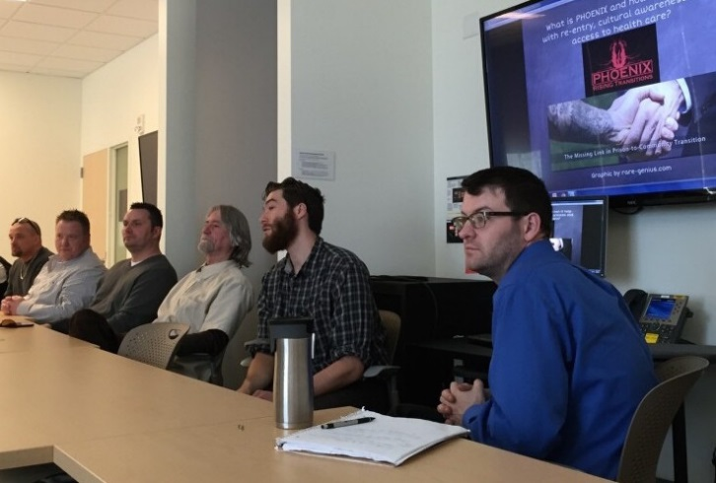
What You Can Do
Get to know ex-cons
Support policy changes in schools, where you work and in the legislature
Host a cultural awareness training where you work
Support mentoring
Serve as a trainer

Slide 12
P.O. Box 723 | Gresham | OR | 97030
www.phoenix-rising-transitions.org
Contact Harry Olsen
harryrobertolsen@frontier.com
(503) 866-1554

Slide 13
Bibliography
14,706 people in Oregon prisons (Oregon Department of Corrections).http://www.oregon.gov/doc/RESRCH/docs/inmate_profile_201507.pdf
1 in 33 Americans is on supervision: Pew Center on the States Report One in 31: The Long Reach of American Corrections, p. 7, March 2009.
32,621 people on supervision in the community in Oregon (Oregon Department of Corrections). http://www.oregon.gov/doc/RESRCH/docs/community_profile_201504.pdf
Oregon DOC Quick Facts: http://www.oregon.gov/doc/GECO/docs/pdf/IB-53-Quick%20Facts.pdf
Binswanger, I. A., Stern, M. F., Deyo, R. A., Heagerty, P. J., Cheadle, A., Elmore, J. G.,& Koepsell, T. D. (2007). Release from prison—a high risk of death for former inmates. New England Journal of Medicine, 356(2), 157-165.
Cuellar, A. E., & Cheema, J. (2012). As roughly 700,000 prisoners are released annually, about half will gain health coverage and care under federal laws. Health Affairs, 31(5), 931-938. doi: 10.1377/hlthaff.2011.0501
Fu, J. J., Herme, M., Wickersham, J. A., Zelenev, A., Althoff, A., Zaller, N. D., ... &Altice, F. L. (2013).Understanding the revolving door: individual and structural-level predictors of recidivism among individuals with HIV leaving jail. AIDS and Behavior, 17(2), 145-155. doi: 10.1007/s10461-013-0590-1
Herbert, K., Plugge, E., Foster, C., & Doll, H. (2012). Prevalence of risk factors for noncommunicable diseases in prison populations worldwide: a systematic review. The Lancet, 379(9830), 1975-1982. doi: 10.1016/S0140- 6736(12)60319-5
Macalino, G. E., Hou, J. C., Kumar, M. S., Taylor, L. E., Sumantera, I. G., & Rich, J. D. (2004). Hepatitis C infection and incarcerated populations. International Journal of Drug Policy, 15(2), 103-114. doi: 10.1016/j.drugpo.2003.10.006
Wang, E. A., Wang, Y., & Krumholz, H. M. (2013). A high risk of hospitalization following release from correctional facilities in Medicare beneficiaries: a retrospective matched cohort study, 2002 to 2010. JAMA internal medicine, 173(17), 1621-1628. doi:10.1001/jamainternmed.2013.9008
Alan, J., Burmas, M., Preen, D., & Pfaff, J. (2011). Inpatient hospital use in the first year after release from prison: a Western Australian population‐based record linkage study. Australian and New Zealand journal of public health, 35(3), 264-269. doi: 10.1111/j.1753-6405.2011.00704.x
Binswanger, I. A., Krueger, P. M., & Steiner, J. F. (2009). Prevalence of chronic medical conditions among jail and prison inmates in the United States compared with the general population. Journal of epidemiology and community health, jech-2009. doi: 10.1136/jech.2009.090662
Freudenberg, N., Daniels, J., Crum, M., Perkins, T., & Richie, B. E. (2005). Coming home from jail: the social and health consequences of community reentry for women, male adolescents, and their families and communities. American Journal of Public Health, 95(10), 1725-1736. doi:10.2105/AJPH.2004.056325.
Heigel, C. P., Stuewig, J., & Tangney, J. P. (2010). Self-reported physical health of inmates: Impact of incarceration and relation to optimism. Journal of Correctional Health Care, 16(2), 106-116. doi: 10.1177/1078345809356523
Kinner, S. A., & Wang, E. A. (2014). The case for improving the health of ex-prisoners. American journal of public health, 104(8), 1352-1355. doi: 10.2105/AJPH.2014.301883
Small, W., Wood, E., Betteridge, G., Montaner, J., & Kerr, T. (2009). The impact of incarceration upon adherence to HIV treatment among HIV-positive injection drug users: a qualitative study. AIDS care, 21(6), 708-714. doi:10.1080/09540120802511869
Wilper, A. P., Woolhandler, S., Boyd, J. W., Lasser, K. E., McCormick, D., Bor, D. H., & Himmelstein, D. U. (2009). The health and health care of US prisoners: results of a nationwide survey. American journal of public health, 99(4), 666-672. doi:10.2105/AJPH.2008.144279
Wolitski, R. J. (2006). Relative Efficacy of a Multisession Sexual Risk–Reduction Intervention for Young Men Released From Prisons in 4 States. American Journal of Public Health, 96(10), 1854. doi: 10.2105/AJPH.2004.056044

